Slide 1
Introduction to Geometric Algorithms
Line Segment Properties

Slide 2
Geometric Algorithms
Line Segments – properties, intersection, Sweeping Lines, Convex Hull finding algorithms- Graham’s Scan, Jarvis’s March Algorithm.

Slide 4
Applications
Convex hull: Given a set of points, find the smallest convex polyhedron/polygon containing all the points.
Line segment intersection: Find the intersections between a given set of line segments.
Voronoi diagram: Given a set of points, partition the space according to which points are closest to the given points.
Linear programming
Closest pair of points: Given a set of points, find the two with the smallest distance from each other.
Farthest pair of points
Largest empty circle: Given a set of points, find a largest circle with its center inside of their convex hull and enclosing none of them.
Euclidean shortest path: Connect two points in a Euclidean space (with polyhedral obstacles) by a shortest path.
Polygon triangulation: Given a polygon, partition its interior into triangles
Mesh generation
Boolean operations on polygons

Slide 5
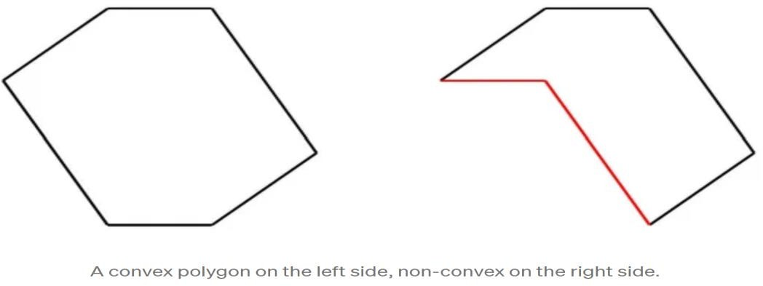
Convex Hull
In geometry, the convex hull or convex envelope or convex closure of a shape is the smallest convex set that contains it.
Given a set of points in the plane, the convex hull of the set is the smallest convex polygon that contains all the points of it.
Convex means that the polygon has no corner that is bent inwards.

Slide 6
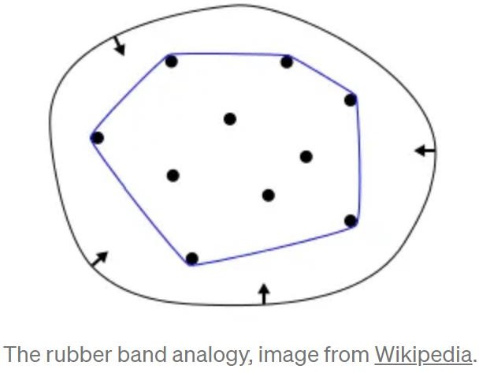
Rubber band Analogy
A useful way to think about the convex hull is the rubber band analogy.

Slide 7
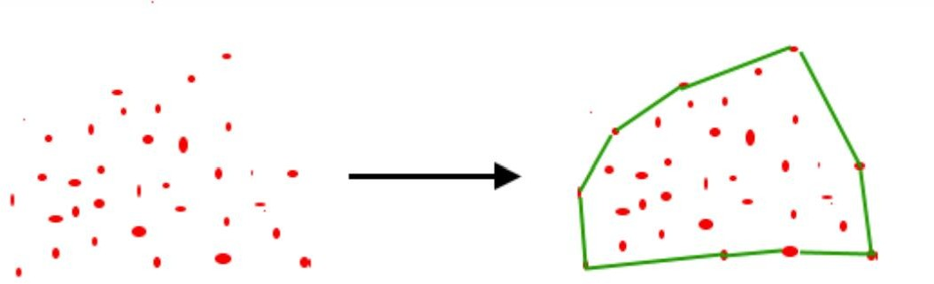
Convex hulls find their application in collision detection and avoidance, Shape analysis, smallest enclosing box, etc.

Slide 8
Line Segment Properties

Slide 9
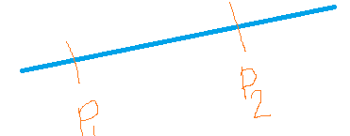
Line Segment
In geometry, a line segment is bounded by two distinct points on a line. Or we can say a line segment is part of the line that connects two points.

Slide 10
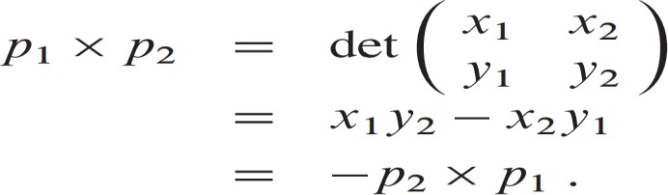
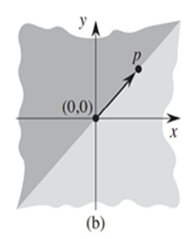
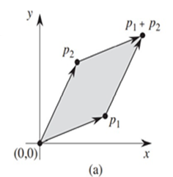
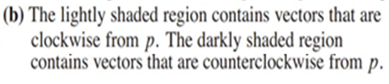

Computing cross products can be interpreted as the signed area of parallelogram formed by the points(0,0),𝑝1,𝑝2,and
𝑝1+𝑝2=(𝑥1+𝑥2,𝑦1+𝑦2).
Cross product

Slide 11
If p1x p2 is positive, then p1 is clockwise from p2 with respect to the origin (0,0);
if this cross product is negative, then p1 is counter-clockwise from p2.
Boundarycondition arises if the cross product is zero; in this case, the vectors are collinear, pointing in either the same or opposite directions.

Slide 12

Given two distinct points p₁ and p2, the line segment is the set of convex combinations of p₁ and p₂.
We call p₁ and p₂ the endpoints of Segment .
Sometimes the ordering of p₁ and p₂ matters, and we speak of the directed segment .
If p₁ is the origin (0, 0), then we can treat the directed segment as the vector p₂.

Slide 13


we shall explore the following questions:
Q1 :Given two directed segments and , Is clockwise from with respect to their common end point
Q2 : How consecutive line segments turn at a common point ?
Q3: Determining whether two line segments intersect ?

Slide 14
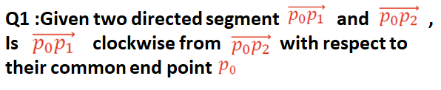
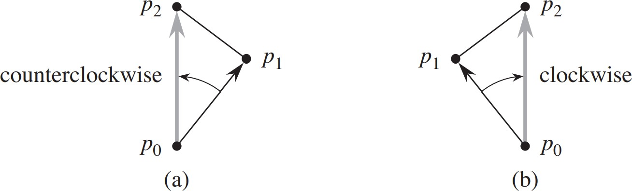

Slide 15
If the calculated value of the cross product is
• Positive --- Clockwise
• Negative -- Counter clockwise
• Zero - Collinear , they are pointing in same or opposite
direction

Slide 16

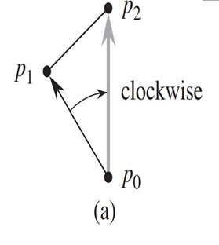
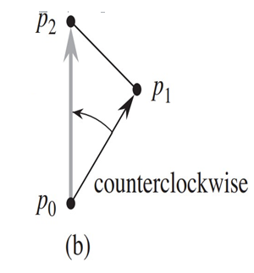
If the calculated value of the cross product is
Positive - Turn right ( Clockwise )
Negative - Turn Left ( Counter Clockwise )

Slide 17

Two line segments intersect if and only if either (or both) of the following conditions holds:
Each segment straddles the line containing the other.
An endpoint of one segment lies on the other segment. (This condition comes from the boundary case.)

Slide 18
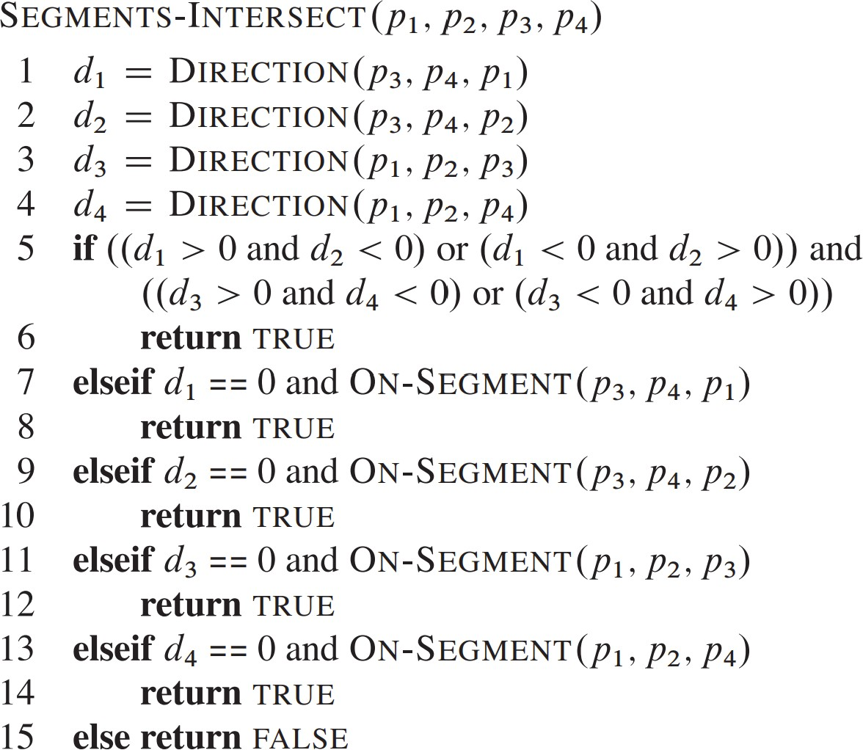

Slide 19
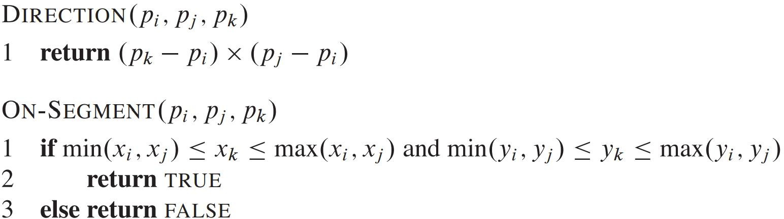

Slide 20
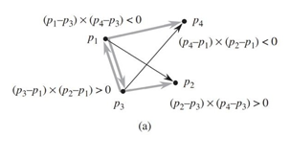
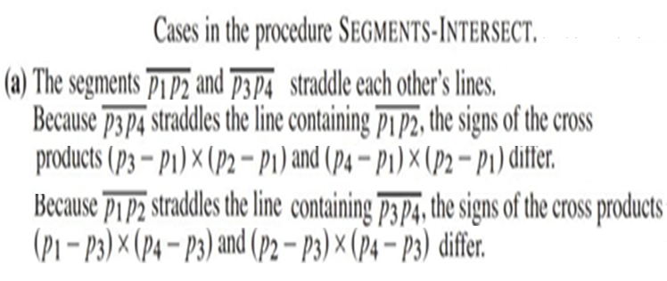

Slide 21
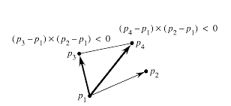
If it does not straddle, then the signs of the cross products are the same.

Slide 22
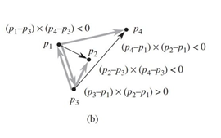

Slide 23
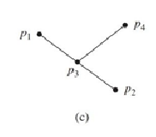
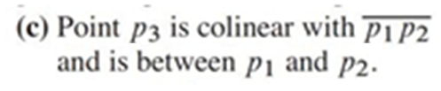
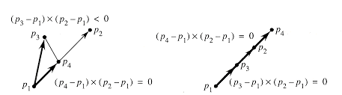
Boundary cases in which at least one of the cross products is zero and the segment straddles.

Slide 24
